Slide 1

IoT BASED DISASTER MONITORING AND MANAGEMENT SYSTEM FOR DAMS(IDMMSD)
GURU NANAK INSTITUTE OF TECHNOLOGY
DEPARTMENT OF ECE
NAGELLI PAVANKALYAN
17831A0465
ECE – 4B
YAMINI P
17831A0473
ECE – 4B
VYDA SUMANA
17831A04B4
ECE – 4B
UNDER THE GUIDANCE OF
Mr. S. SIVAIAH
Assistant Professor
ECE Department, GNIT

Slide 2
INTRODUCTION
Dams are of major importance, primarily because of their use for generating hydroelectricity and irrigation purposes. Mismanagement of dams can lead to manmade disasters. Currently dams in our state are being monitored and controlled manually. This manual intervention can increase the probability of error and also results in time lag in decision making. The aim of this project is to design and implement an IoT based Disaster Monitoring and Management System for Dams (IDMMSD). The proposed system involves real-time monitoring of water levels of a group of dams under study. Water levels may vary due to drastic changes in water levels of connected rivers or lakes, or due to excessive rainfall in the catchment area. The proposed project includes a mechatronics system to open the shutters at the heights pre calculated. The system comprises of sensor nodes, smart controller and communication system. The proposed system is an app based IoT system which will monitor and send real time parameters related to Dam and weather conditions.

Slide 3
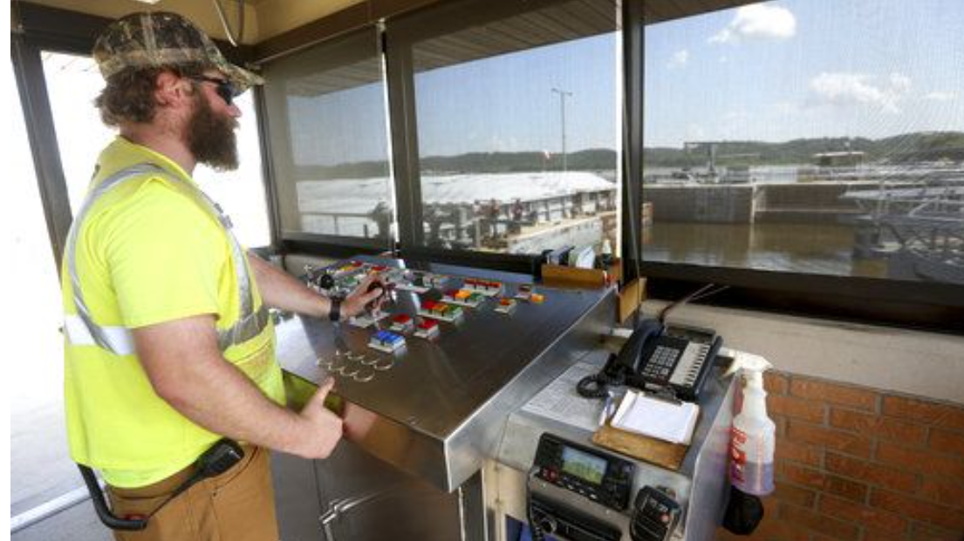
EXISTING SYSTEM
In the earlier system the dam shutter can control by the keypad or manual operations only. We cannot control the dam shutter immediately in the existing system because if the water reached the abnormal level the shutter will damage. So we go for a new system to overcome this disadvantage.

Slide 4
S.No. | AUTHORS | TITLE | COMPONENTS USED
1. | Anita Gehlot, Rajesh Singh, Sushabhan Choudhury, Bhupendra Singh. (2019) | Wireless Disaster Monitoring and Management System for Dams. | Level sensor, Discharge sensor, Rain sensor, 2.4 GHz modem, MAX232- USART , GSM module, Hooter, USB to Serial cable, DB9 (connector).
2. | S.Rajapriya, A.Abinaya, V.Subashini (2019) | IOT Based Dam Monitoring System. | waterflow sensor, ultrasonic sensor, vibration sensor, level converter, Driver, Relay, Motor, LCD display, Buzzer, Load cell, switches. The software used here is MPLab IDE, PIC16F877A.
3. | Dr.A.Kavitha, R. Jai Ganesh, Dr.S.Muralidharan (2020) | Automatic Dam Shutter Control using Wireless Sensor. | Sensors GSM warning system RF warning system, Gate control system, mcu

Slide 5
S.No. | AUTHORS | TITLE | COMPONENTS USED
4. | Kavitha.R, Jayalakshmi.C, Senthilkumar(2018) | Dam Water Level Monitoring and Alerting System using IoT | Node mcu microcontroller, Ultrasonic Sensors, Esp8266 Wi-Fi module
5. | S. Janani , J. Joy Sing, L. Mayuri , D. Mansur Ali (2020) | Water Level Monitoring and Management of Dams using IoT | Arduino Uno, Ultrasonic Sensor, Servo Motor, GSM Sim 800A.
6. | L RaviKumar, Jayalakshmi Rajeevan, Kavya Baiju, Manish Varghese, Nimmy Agnes, S. Gajendra Babu (2019) | Dam Automation and Application Using IOT | Ultra sonic sensors (SR04), Node MCUV2(ESP8266 MOD), Relay(5V), Buck converter, LED and Buzzer, motor.
7. | Suyash Sharma, Vinayak Sadanand, MD. Nouman Molla, Prof. S. G. Mohite(2018) | Dam Monitoring and Safety Protocol System. | Arduino module, Bluetooth module, Ultrasonic sensor, Servo motor, Water sensor, Water flow sensor.

Slide 6
S.No. | AUTHORS | TITLE | COMPONENTS USED
8. | Shaik Roshan, Dr. M. Muthuvinayagam, S. Manivannam. (2020) | IoT Based Remote Monitoring and Controlling for Shutter Systems | Arduino, gsm, rain sensor, lcd, iot, level sensor.
9. | J.Janet, S.Balakrishnan, S.Sheeba Rani(2019) | IOT Based Lake and Reservoir Management System. | Arduino Uno ESP8266 Wi-Fi module Moisture Sensor, Water Pump Motor Driver.
10. | prof.Seema Idhate Ashish Bilapatte Avinash Rathod Hanuman Kalbande (2018) | Dam Monitoring System Using Wireless Sensor Networks | LPC2138 micro controller, temperature sensor, humidity sensor, water level, lcd, RF transmitter, rain drop sensor.

Slide 7
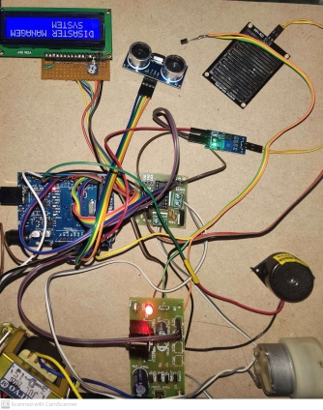
PROPOSED SYSTEM
In this system the dam shutter is connected to the microcontroller. The water level sensor is used to measure water level in the dam. The pump motor is used to pump the water from dam. The water level is measure continuously by the level sensor and the value is compared to the threshold value continuously.

Slide 8
BLOCK DIAGRAM & EXPLANATION
Block Diagram :
Power Supply
Arduino UNO
(ATmega328P)
LCD
Water Level Sensor
IOT Module
Rain fall sensor
L293D
Ultra Sonic sensor
Motor
Temperature sensor
Buzzer

Slide 9
Explanation :
IOT based disaster management and monitoring system is built with the components mentioned above in the block diagram.They are temperature sensor, Ultrasonic sensor, rainfall sensor, water level indicator, LCD, IoT module, DC motor, L293D motor driver, buzzer. Arduino UNO is the controlling unit of the project which collects the data collected from the input devices and process the data and gives the appropriate output to the respectice output devices in accordance to the program in the controller. Water lever sensor is used here to monitor the water levels in the dam. Rain fall sensor to sense the rain. Ultrasonic sensor to measure the distance between dam gate and water level. Temperature senor to measure the temperature. LCD to display the measured values by the controller. Buzzer to alert the people nearby the dam if the water level in dam increase more than the normal level. IoT module to upload the data collected by the controller into the cloud securely and the data collected is securely accessed by the authorised persons. DC Motor to open and close the dams in accordance to the water level in the dam and the motor driver is used to control the motor.

Slide 10
HARDWARE COMPONENTS
Arduino UNO
Water level sensor
Rain fall sensor
Ultra Sonic sensor
Temperature sensor
LCD
Buzzer
IoT Module
L293D MOTOR DRIVER
DC MOTOR

Slide 11
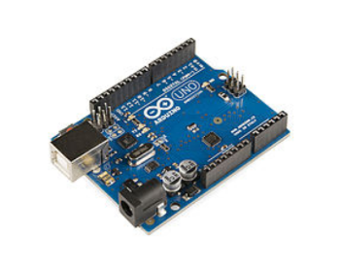
1. Arduino UNO
Arduino Uno is a microcontroller board based on the ATmega328P.
It has 14 digital input/output pins (of which 6 can be used as PWM outputs), 6 analog inputs, a 16 MHz quartz crystal, a USB connection, a power jack and a reset button.

Slide 12
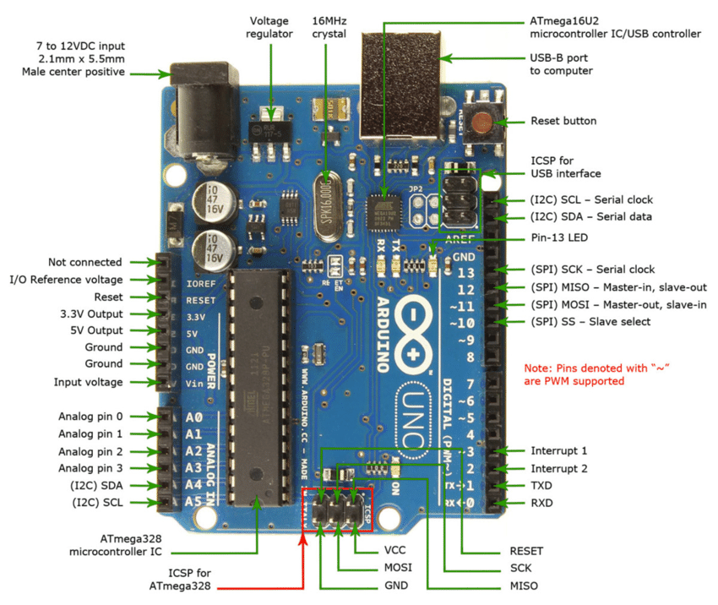
Arduino UNO Pin Diagram

Slide 13
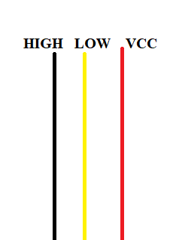
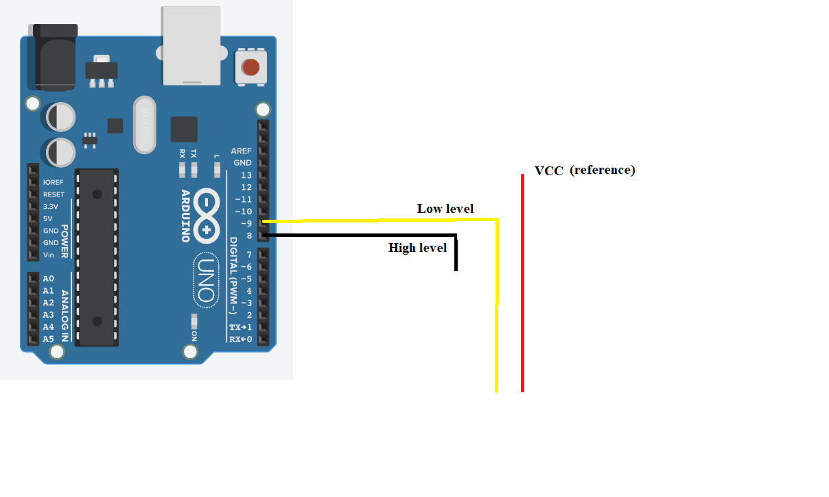
2. Water level sensor
The water level sensor contains three wires in which one wire is consider as a reference (i.e., VCC), second wire is considered as a low level indicator and another wire is assumed to be the high level indicator. The low level and high level wires are connected to the controller analog or digital pins.
Interfacing Diagram

Slide 14
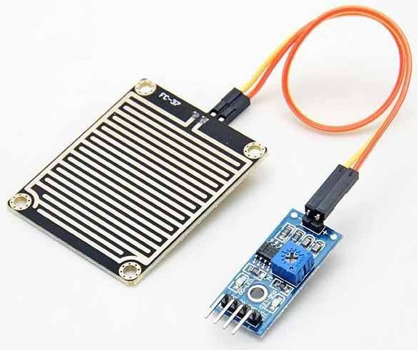
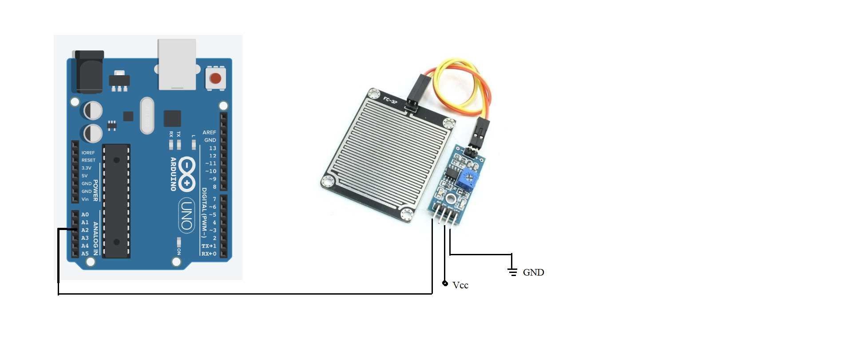
3. Rainfall sensor
A rain sensor is one kind of low-cost electronic sensor which is used to detect the rainfall or water drops. It works as a switch.
Interfacing Diagram

Slide 15
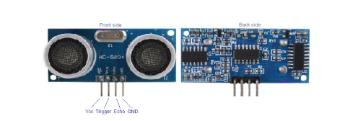
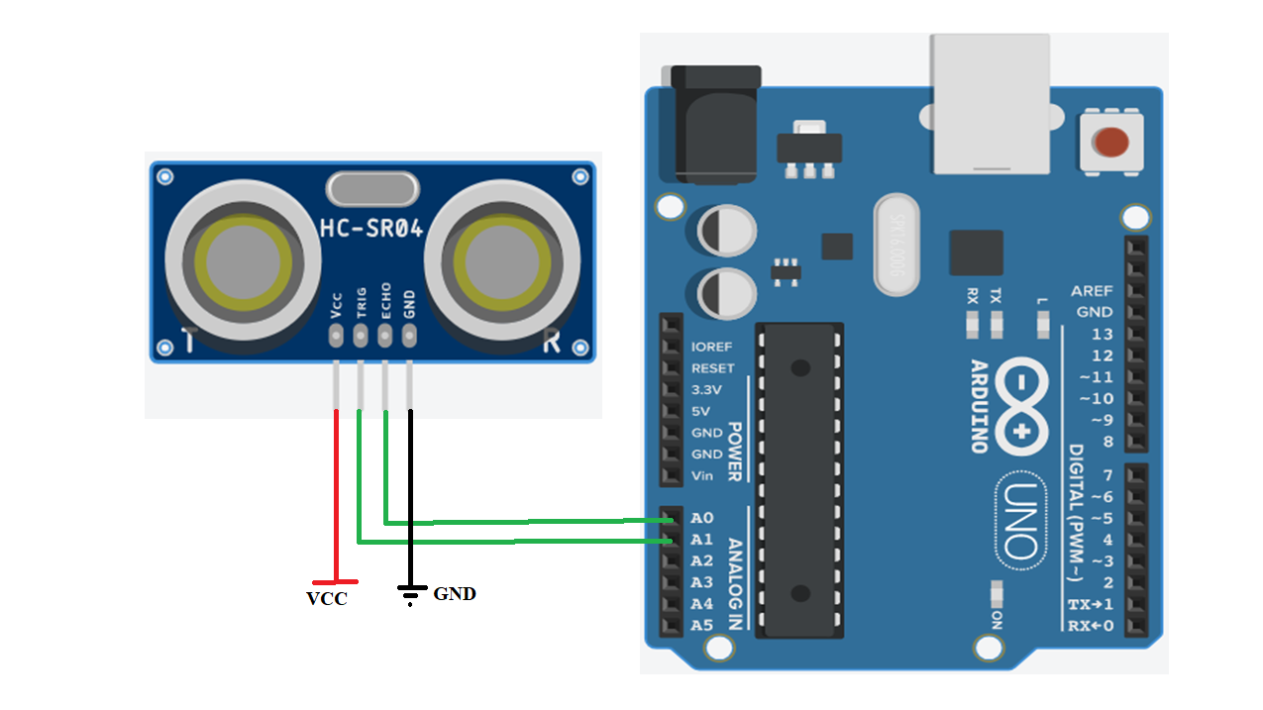
4. UltraSonic Sensor
Ultrasonic sensor is device that use sound waves above 20,000 Hz, beyond the range of human hearing, to measure and calculate distance from the sensor to a specified target object.
Interfacing Diagram

Slide 16
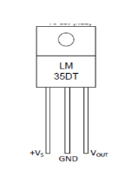
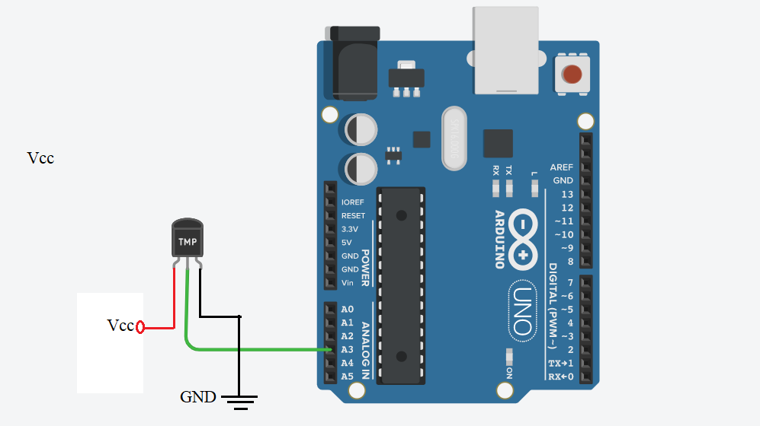
5. Temperature Sensor
LM35 is a temperature sensor that gives output as an analog signal which is proportional to the instantaneous temperature.
The output voltage can easily be interpreted to obtain a temperature reading in Celsius.
Interfacing Diagram

Slide 17
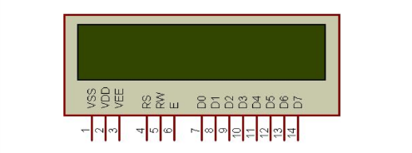
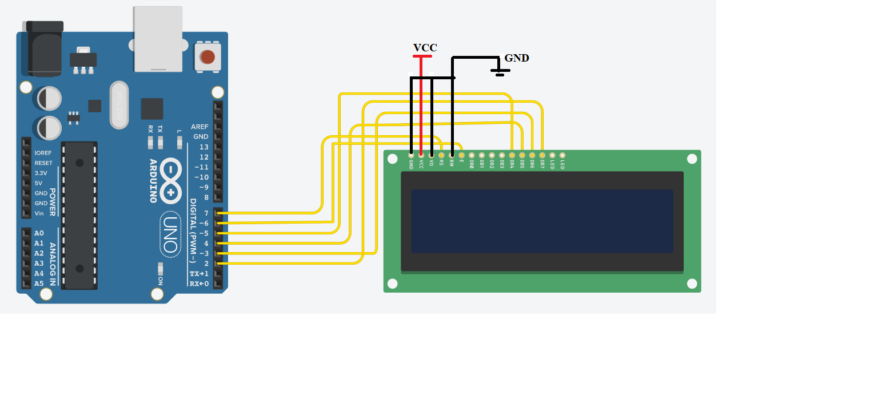
6. LCD
LCD uses a liquid crystal to produce a visible image
LCD’s technologies allow displays to be much thinner when compared to a cathode ray tube (CRT) technology.
Interfacing Diagram

Slide 18
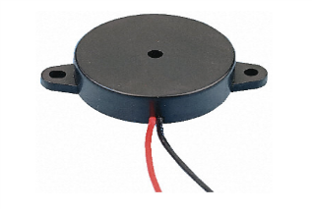
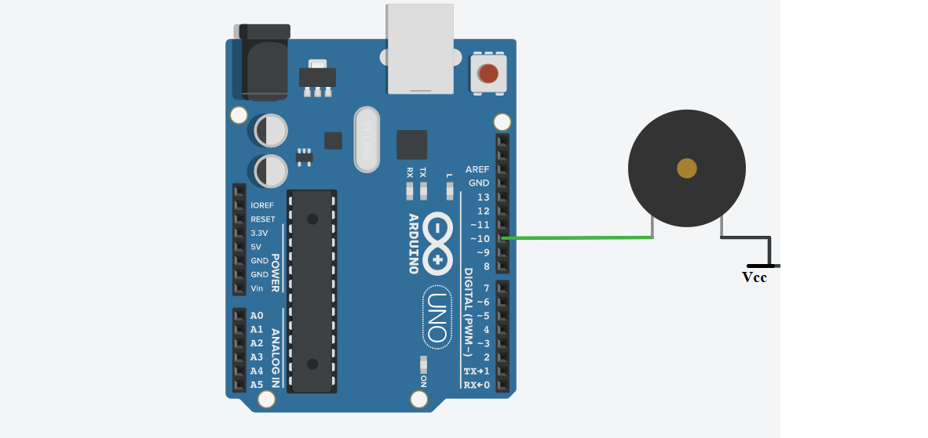
7. Buzzer
A buzzer is a signaling device, usually electronic, typically used in automobiles, house hold appliances such as a microwave oven.
Interfacing Diagram

Slide 19
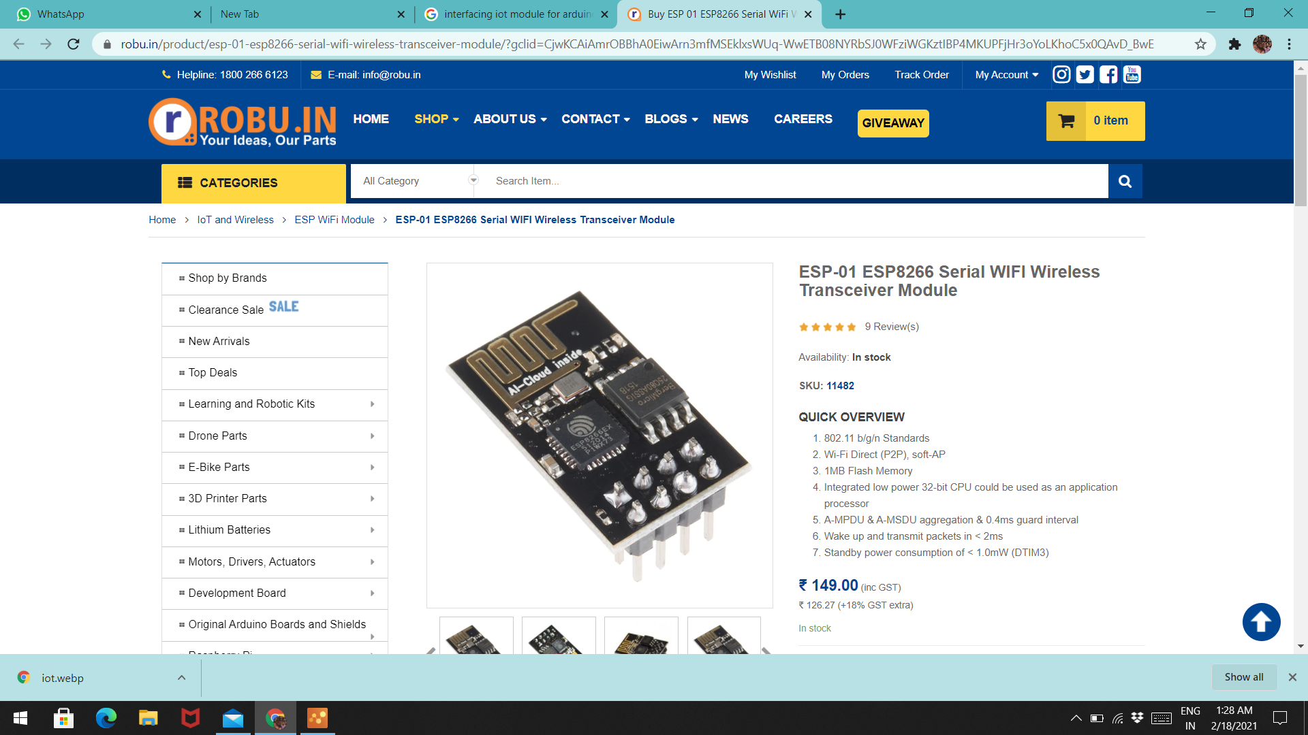
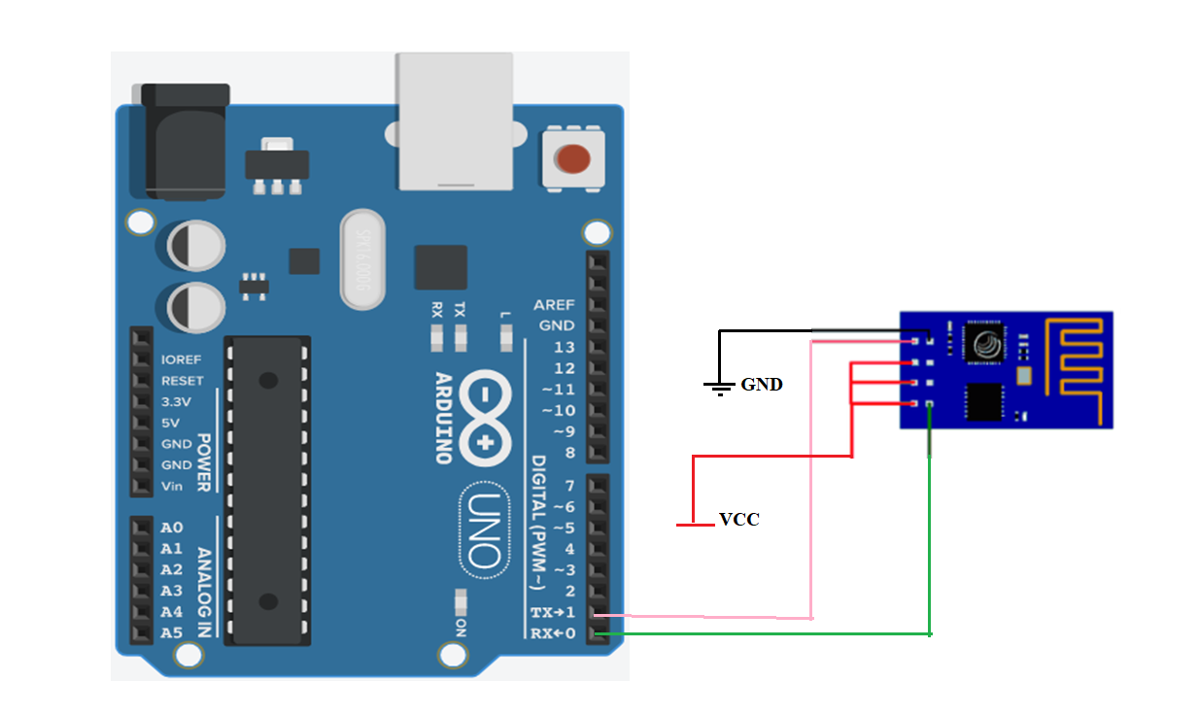
8. IOT Module
An IoT module is a small electronic device embedded in objects, machines and things connected to wireless networks and sends and receives data.
Interfacing Diagram

Slide 20
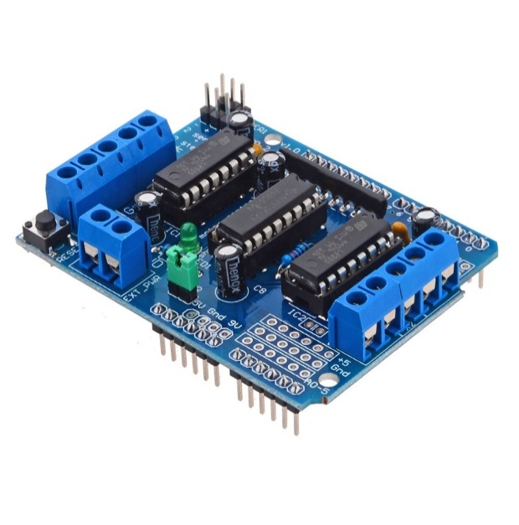
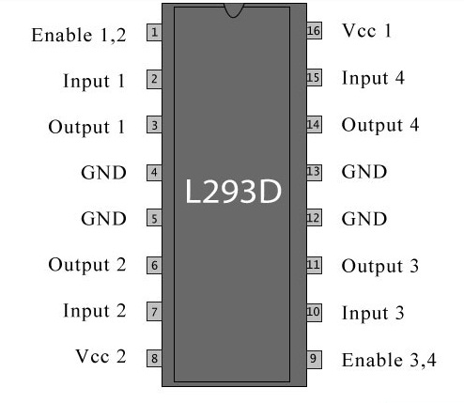
9. Motor Driver
L293D IC is a typical Motor Driver IC which allows the DC motor to drive on any direction. This IC consists of 16-pins which are used to control a set of two DC motors instantaneously in any direction. It means, by using a L293D IC we can control two DC motors. As well, this IC can drive small and quiet big motors.

Slide 21
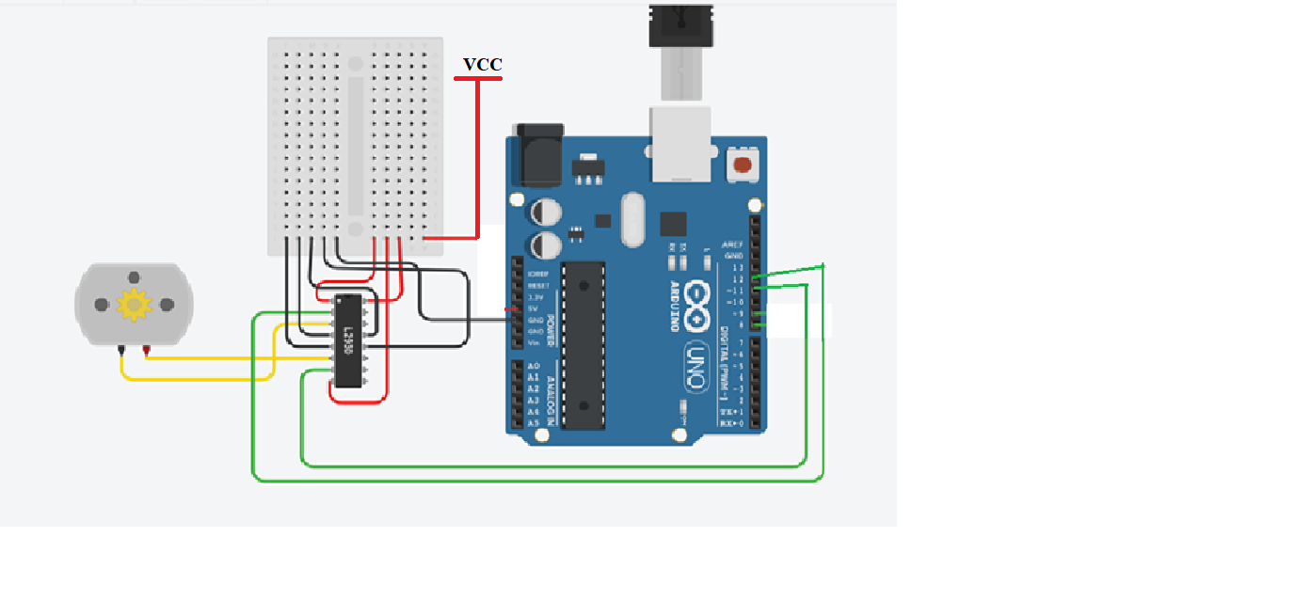
Interfacing Diagram

Slide 22
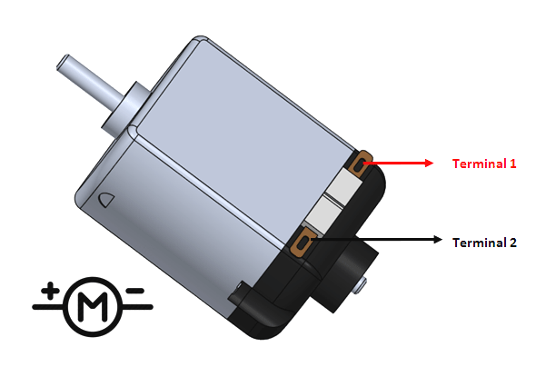
10. DC Motor
A DC motor is an electrical machine that converts electrical energy into mechanical energy. In a DC motor, the input electrical energy is the direct current which is transformed into the mechanical rotation.
Interfacing Diagram

Slide 23
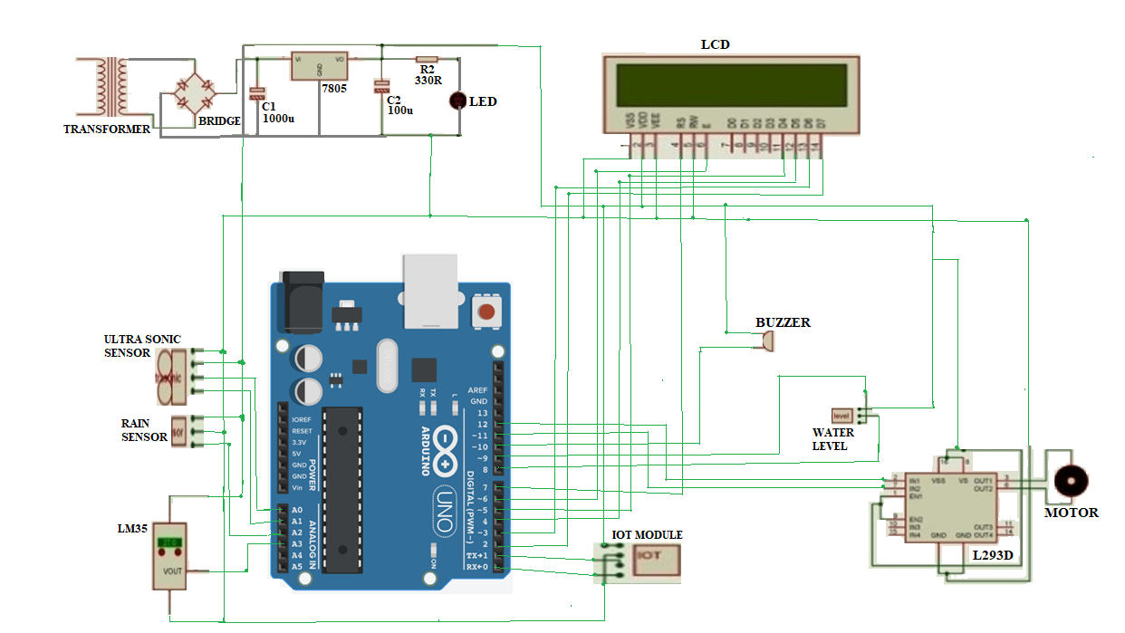
CIRCUIT DIAGRAM AND EXPLANATION

Slide 24
Explanation :
In this IoT based Disaster Monitoring and Management System for Dams(IDMMSD), the transformer is connected to Bridge Rectifier and Bridge Rectifier is connected to capacitors and regulators.
Buzzer is connected to digital pin 10 of arduino and power supply. Here three wires act as Water level sensor ,one wire is connected to VCC,other two wires are connected to 8 and 9 digital pins of Arduino.
Temperature sensor is connected to VCC , gnd to ground and analog output to arduino pin A3. Ultrasonic sensor is connected VCC to power supply, GND to ground, trig to A0 pin and echo to A1 pin of arduino. Rain fall sensor is VCC connected to Vcc , GND to ground and A2 pin of arduino.
LCD pins(D4,D5,D6,D7) connected to arduino(5,4,3,2)digital pins and RS pin is connected digital pin 7, enable is connected to digital pin 6.r/w pin to the iot module.
In the Iot module is transmitter is connected to receiver of arduino and receiver to transmitter of arduino. DC Motor is connected to motor driver and motor driver is connected to digital pins 11,12 of arduino and power supply.

Slide 25
SOFTWARE USED
Arduino IDE Software
Arduino is an open-source electronics platform based on easy-to-use hardware and software. Arduino boards are able to read inputs - light on a sensor, a finger on a button, or a Twitter message - and turn it into an output - activating a motor, turning on an LED, publishing something online.
We can tell our board what to do by sending a set of instructions to the microcontroller on the board. To do so you use the Arduino programming language, and the Arduino Software (IDE), based on Processing. Arduino software is growing through the contributions of users worldwide.
The Arduino software is easy-to-use for beginners, yet flexible enough for advanced users. It runs on Mac, Windows, and Linux. Teachers and students use it to build low cost scientific instruments, to prove chemistry and physics principles, or to get started with programming and robotics.

Slide 26
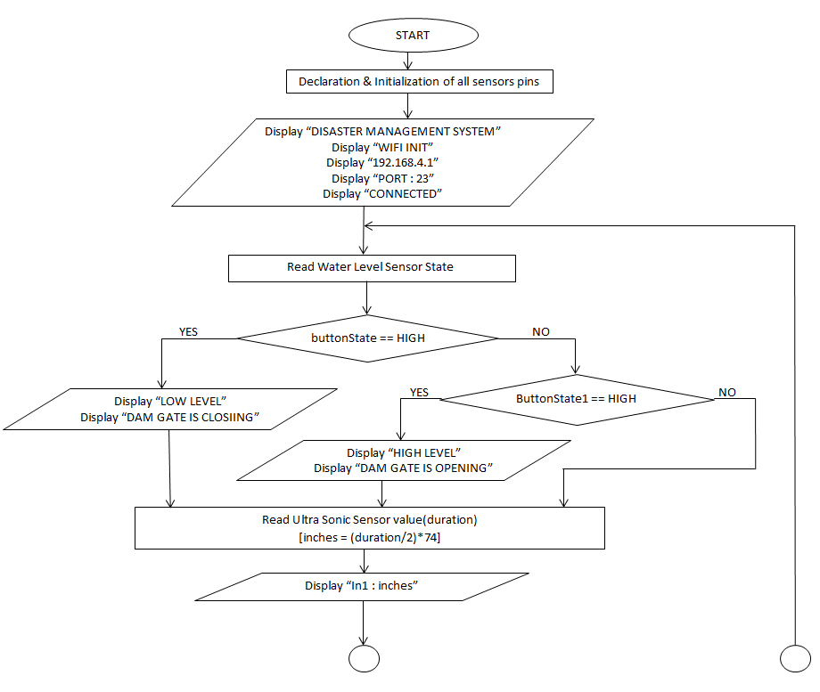
Flow chart

Slide 27
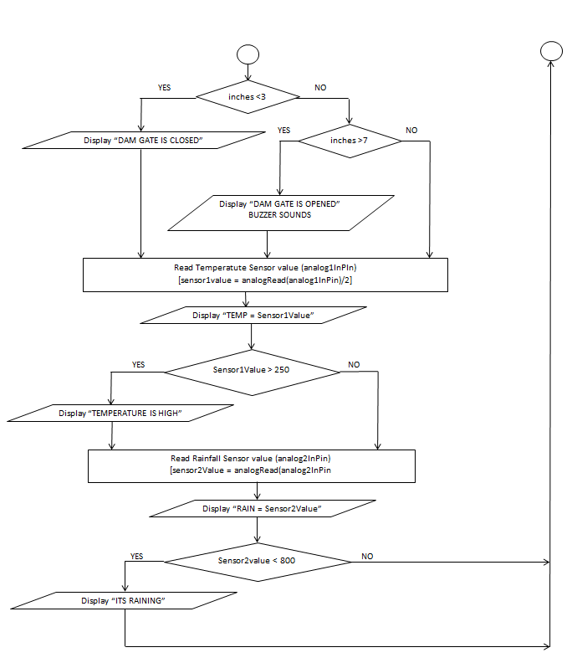

Slide 28
Algorithm
Step1: start the proposed system.
Step2: Initialize and define all the required pins
Step3: Display on the LCD as “DISASTER MANAGEMENT” when system starts.
Step4: Display on the LCD as “WIFI INIT” when we are initializing the wifi with app.
Step5: Display on the LCD as “192.168.4.1” when we are giving the ip address to app.
Step6: Display on the LCD as “Port:23” when we give port address to app.
Step7: Display on the LCD as “CONNECTED” when iot module is connected to app.
Step8: It detects the water level sensor state.
Step9: If the water level sensor “buttonState==HIGH” it will display on LCD as “LOW LEVEL” and “DAM GATE IS CLOSING”.
Step10: If the water level sensor “buttonState1==HIGH”it will display on LCD as “HIGH LEVEL” and “DAM GATE IS OPENING”.

Slide 29
Step11: It detects the ultra sonic sensor value(duration) and calculate in terms of inches using a formula( inches=(duration/2)*74).
Step12: Display on theLCD as “In1:inches” after calculation.
Step13: If the calculated value is less than 3 inches it will display on LCD as “DAM GATE IS CLOSED” .
Step14: Else If the calculated value is greater than 7 inches it will display on LCD as “DAM GATE IS OPENED” and buzzer will be on here.
Step15: It detects the Temperature sensor value(analog1InPin) in terms of sensor1Value by the formula(sensor1Value=analogRead(analog1InPin)/2).
Step16: Display on the LCD as “TEMP = sensor1Value” after calculation.
Step17: If the sensor1Value is greater than 250 it will display on LCD as “Temperature is HIGH” .
Step18: It detects the Rainfall sensor value(analog2InPin) in terms of sensor2Value by the formula(sensor2Value=analogRead(analog2InPin)).
Step19: Display on the LCD as “RAIN = sensor2Value” after calculation
Step20: If the sensor2Value is lesser than 800 it will display on LCD as “ITS RAINING”
Step21: The process will repeat the steps again from step8.

Slide 30
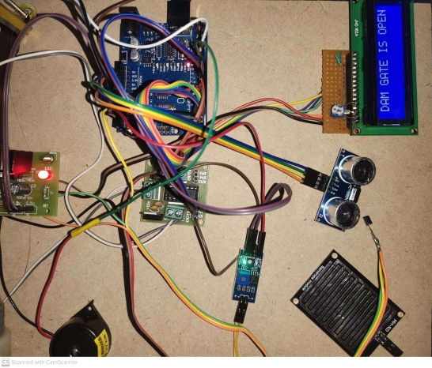
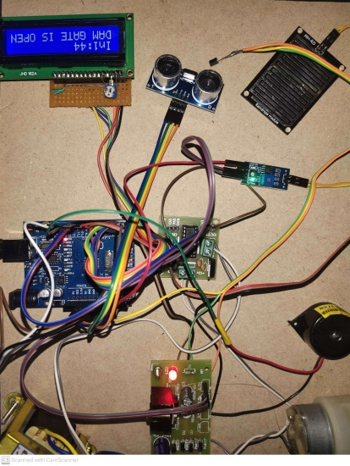
RESULTS
Water level sensor output
UltraSonic sensor output

Slide 31
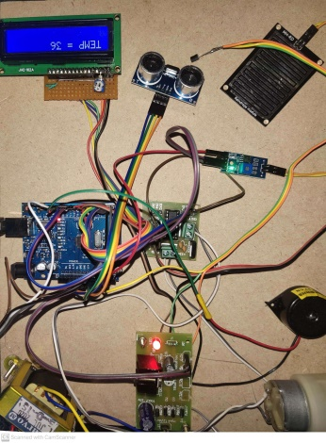
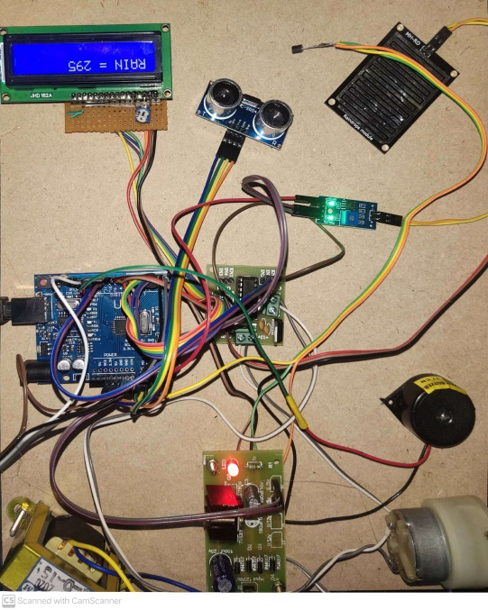
Temperature sensor output
Rainfall sensor output

Slide 32
QUERIES ?

Slide 33
THANK YOU

